Slide 1

ELK/Logstash 101
Or: How I learned to stop worrying and love the log

Slide 2
Who am I? / Why does this matter?
Handle: Embalmed
Network Security Professional
Strong systems background
Increasingly devOps
Logs matter! (security, trending, etc)
Accessing logs quickly matters
Even more so at scale. More servers, more log sources, what is worth looking at?
Filtration / normalization of input data

Slide 3


Evolution of my Logging Infrastructure
To understand what we can do with ELK, we should really understand what it was like before ELK.
This is my personal path through the wonderful world of happy little logs.

Slide 4
Goals of a logging infrastructure
Troubleshoot/Investigate Issues.
Why did the app crash?
Who last logged into the server and what did they do?
Predict failures (to troubleshoot less issues ;) )
Analyze patterns in as near to real time as possible
Usage patterns
Malicious activity / ALERTING
Load and scalability planning
Be Scalable
Must be able to handle increasingly more data sources / types

Slide 5
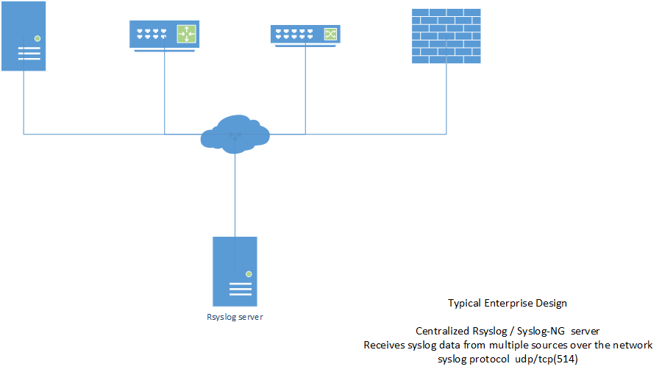

Slide 6
What’s wrong with that?
Scalable only by limiting syslog sources (usually by region / datacenter)
Data is not easily searchable
Grepping is harder when mixed w/ compressed and non-compressed logs
Aka finding the data takes some time
Analytics usually run as nightly jobs on the previous days logs.
We’re also not actually doing anything with the logs at all other than storing them. Certainly not in real-time.

Slide 7
Simple Event Correlator
Pair log lines within specific time windows
“starting some job”
“job finished success”
Alert if this process takes too long, or doesn’t complete at all.
Log suppression
Suppress noisy logs to a whisper (dedupe)
Thresholding
X number of matching lines in Y timewindow

Slide 8
SEC Samples
Show some SEC samples
Show rsyslog conf file

Slide 9
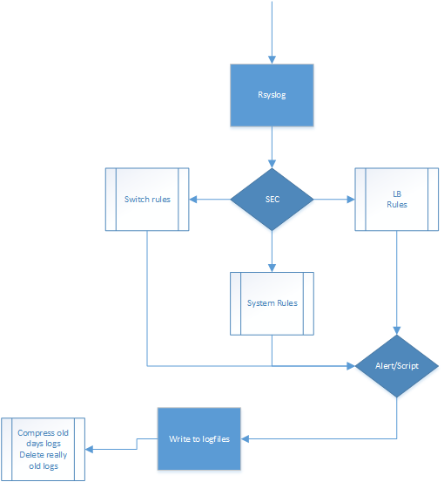
One piece of the puzzle down…
Here we add Simple Event Correlator into the log flow.
Now we are able to alert in real-time and detect malicious activity.
Still grepping our logs on all the central log servers though….

Slide 10
Searchability
We’ve solved the real time alerting problem, but boy our troubleshooting still takes a long time.
We’ve got to log into one of 10 central logging servers to grep through a mix of bzip’d and flatfile logs.
It’s just not efficient to search our data, so what can we do?
Time to introduce a scalable, searchable, solution

Slide 11


What is Logstash?/ELK
When most people say Logstash, they are really talking about ELK (now)
Mostly java based applications (kibana is javascript)
ELK= Elasticsearch, Logstash, Kibana
Elasticsearch is a distributed real time search and analytics engine
Built on top of lucene
Logstash is a log scrubber and parser
Parses into JSON format
Kibana is a data visualization engine that interacts with underlying Elasticsearch clusters. (Dashboards, graphs, etc)

Slide 12
New things with ES
ELK is a fairly new initiative by the folks at Elasticsearch (ES)
Elasticsearch was originally on its own
The maker of kibana was hired on at ES and became a core part of the stack
Logstash moves from a separate project to live under the ES umbrella
Now offer a commercial monitor/management product Marvel
Offer commercial training
Deb/RPM packages for both ES, Logstash now
Elasticsearch 0.9 -> 1.1.0
Logstash 1.2 -> 1.4

Slide 13
Scalability
Each piece of the ELK stack is built with scalability in mind
Elasticsearch is designed for clustering and scalability. Multicast / unicast cluster membership is built into the core as well as data redundancy. ES can also be split into 3 roles, search head, cluster coordinator, and data node.
Logstash can be split into both log shippers, and log indexers and read from multiple data streams.
Kibana talks directly to your elasticsearch, so it’s as scalable as it is.

Slide 14
Logstash
Logstash has 23 Inputs | 18 Filters | 40 Outputs
Full list of inputs available http://logstash.net/docs/1.4.0
Debian package config locations:
/etc/default/logstash
/etc/init/logstash.conf
/etc/logstash/conf.d/*

Slide 15
Logstash -- Getting Data In
Logstash can listen locally as a syslog server
Log Shippers (next slide)
File input – can watch directories / read from local files and maintain file position [milestone 2]
Rabbitmq [milestone 1]/ Zeromq [milestone 2]
Redis [milestone 2]
Redis keeps getting mentioned as the de-facto method, but the teams I know who use it have had the log shipping break down multiple times, and my team has not.

Slide 16
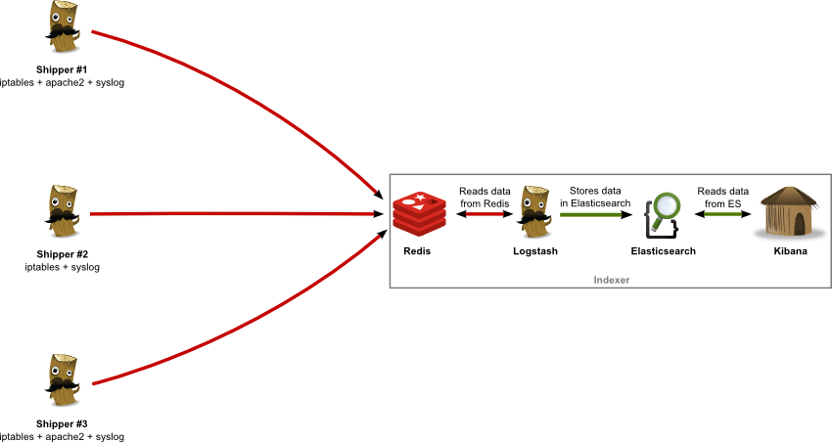
Redis
Redis is a popular middle tier log shipper/queue. It is also scalable.
Maintains a local queue of logs in case of network disruption, but it will eventually over-run.
Allows restart of logstash without data loss.

Slide 17
Log Shippers
Logstash agent – run logstash shipper config, installs/comes with whole logstash package
Beaver – can use an SSH tunnel to transmit chomped logs to logstash
http://beaver.readthedocs.org/en/latest
logstash-forwarder (formerly lumberjack) – openSSL transmission of logs
lightweight
lumberjack protocol [Milestone 1]
https://github.com/elasticsearch/logstash-forwarder

Slide 18
Logstash – Filtering Data
Normalize/convert timestamps
Collect multiline logs as one log (stacktrace, pf fw logs)
Remove extraneous data
Parse data fields from logs using regex or grok patterns
http://grokdebug.herokuapp.com
Add tags, extra data to logs

Slide 19
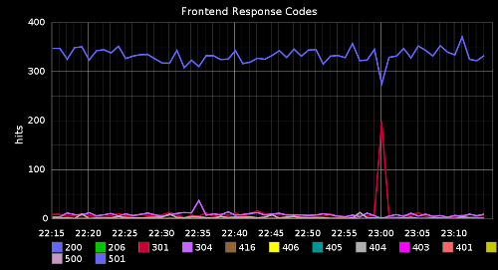
Logstash – Outputs
Output to elasticsearch (primary use for logstash)
Output to graphite through statsd
Output directly to graphite
You can even output to redis
Infinitely looping logs anyone?

Slide 20
Elasticsearch
Elasticsearch nodes can server multiple roles based on several settings in the elasticsearch.yml file.
Master/coordinator node.master=true, node.data=false
Workhorse/data storage node.master=false,node.data=true
Search load balancer node.master=false, node.data=false
Debian package config locations
/etc/default/elasticsearch
/etc/elasticsearch/elasticsearch.yml
/etc/elasticsearch/logging.yml

Slide 21
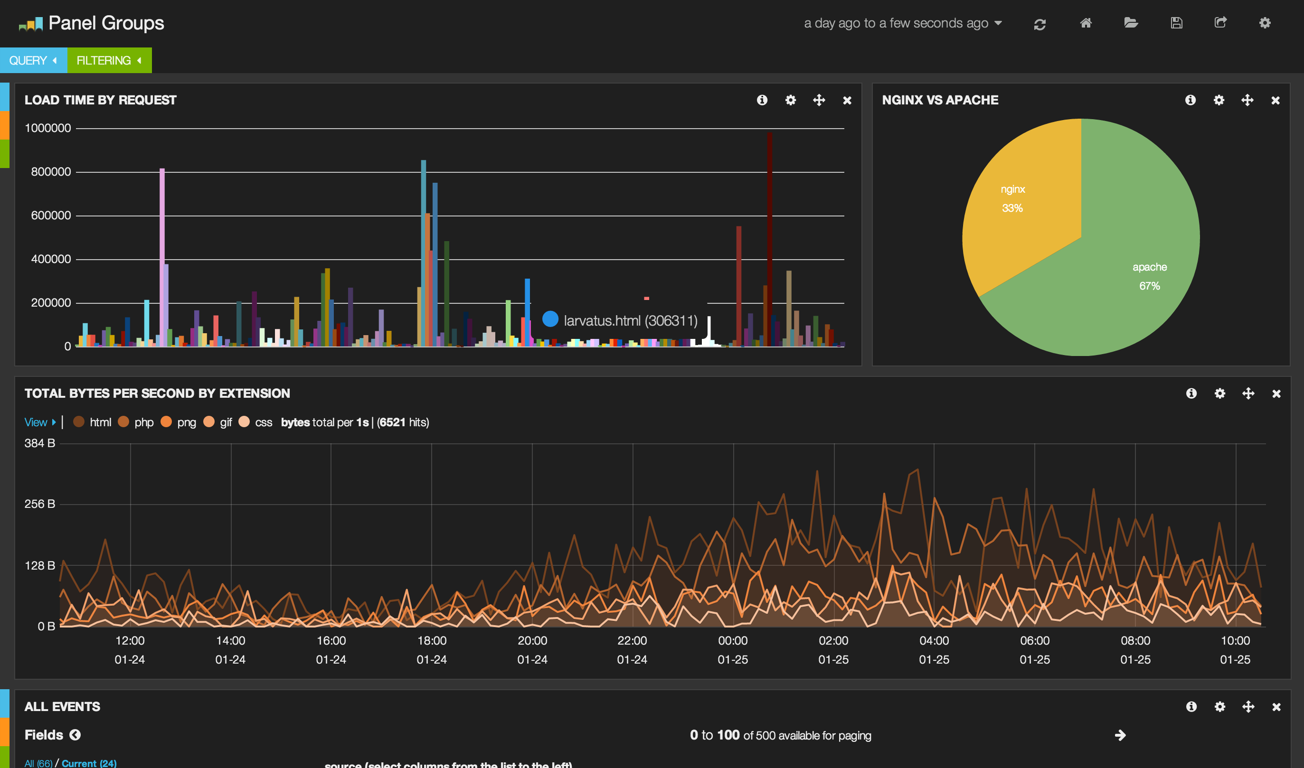
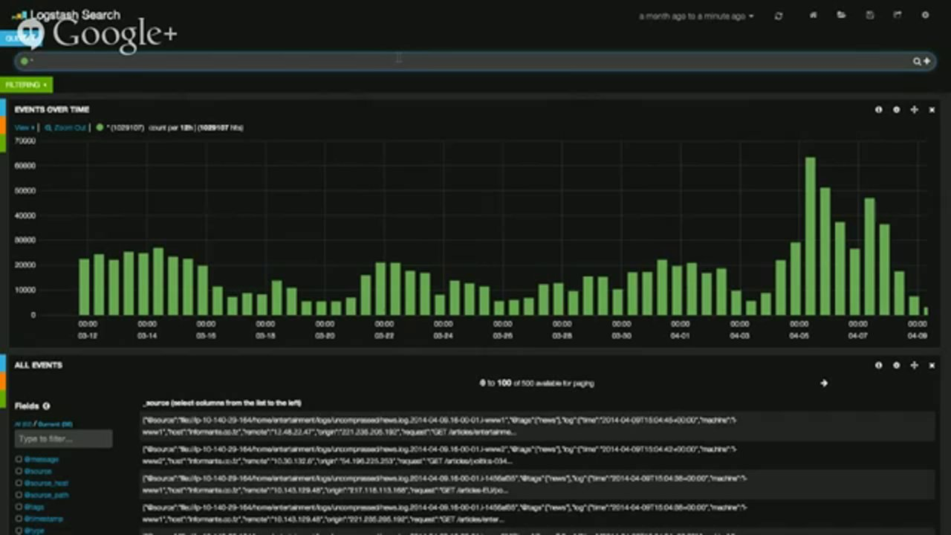
Kibana
The web-ui frontend to your elasticsearch-ified data.
Remember those logstash filters that created new fields?
They *automatically* show up in kibana for you to use for searching or trending.

Slide 22
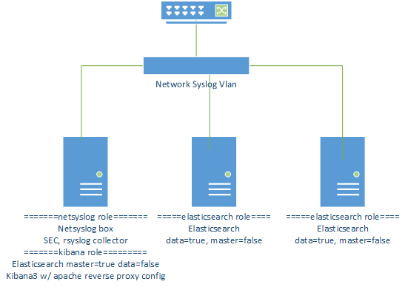
Oh right.. That evolution thing

Slide 23
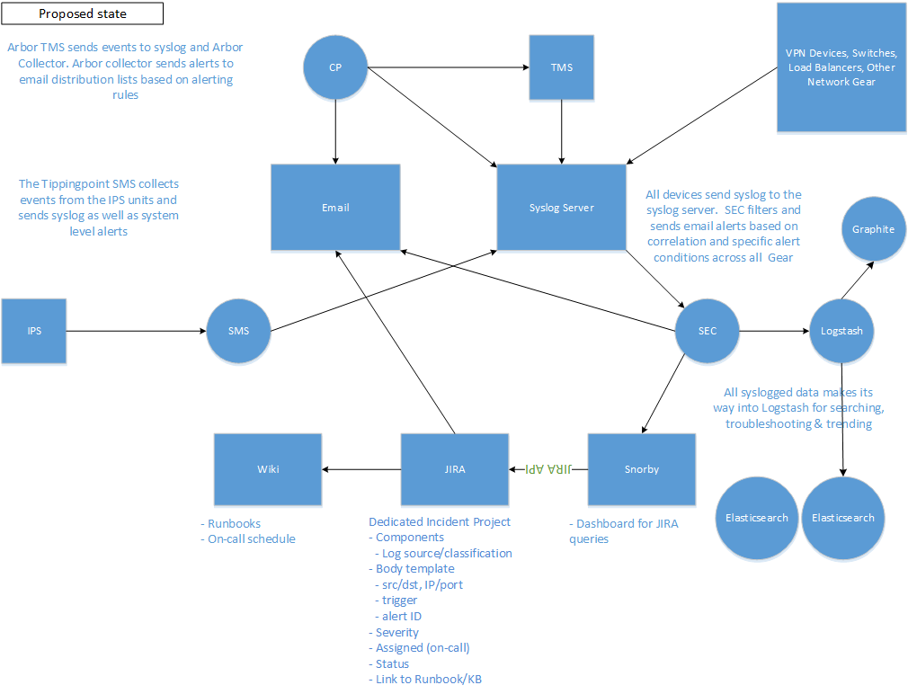

Slide 24
Installing EL
Luckily for us, now there are rpm and deb packages available for most *nix distros for Elasticsearch and Logstash.
Add elasticsearch repositories to your apt/yum configs
http://www.elasticsearch.org/guide/en/elasticsearch/reference/current/setup-repositories.html
Or, download the deb /rpm packages manually from http://www.elasticsearch.org/overview/elkdownloads/
Kibana is downloaded from the above link, but is a tarball, not a deb/rpm
Config file locations in the previous slides

Slide 25
Installing K
Kibana needs to be setup for apache or nginx
Kibana must talk directly to your elasticsearch cluster on port 9200
The kibana sample directory has a few samples for setting up reverse proxy on apache, including ldap and basic authentication.
The Kibana config.js file must be edited to point to wherever your elasticsearch cluster is listening
If you are using the apache reverse proxy you need to point it at your webserver on http/https without port 9200

Slide 26
Elasticsearch adjustments/tweaks
Cluster.name: set your cluster name, this is used to identify different clusters, and helps in multicast discovery
Node.name: unique node name for your node, I use fqdn
Node.master & node.data settings for your role.
Network.host:
0.0.0.0 for kibana host so that we can still proxy 127.0.0.1:9200 and not expose it directly
Machine ip for data node
Transport.tcp.port: by default 9300-9400, you may want to change this
ES_HEAP_SIZE, MAX_OPEN_FILES in /etc/default/elasticsearch

Slide 27
ES shards/replicas
Index.number_of_shards
Index.number_of_replicas
Having more *shards* enhances the _indexing_ performance and allows to _distribute_ a big index across machines.
Having more *replicas* enhances the _search_ performance and improves the cluster _availability_.
Default is 5 shards, 1 replica
If you are running a 1 node cluster, you need 0 replicas

Slide 28
Cluster communications
Default clustering is done multicast to 224.2.2.4
Multicast means you probably need to be on the same vlan
Cluster name matters
Picks a port 9300-9400 by default to communicate
Adjusted with transport.tcp.port setting
Clustering can be done unicast
You will have to manually list out all your cluster members in the config file for unicast discovery

Slide 29
Elasticsearch api commands
Curl –XGET http://localhost:9200/_cluster/health?pretty=true
Red: some / all primary shards unavailable
Yellow: primary shards allocated, but not all replicas
Green: all shards and replicas allocated
A single node elasticsearch will always be yellow status because there are no replicas
Curl –XDELETE http://localhost:9200/logstash-2014.04.18
Delete an index. (logstash indexes are in date format)
Curl –XGET http://localhost:9200/_cluster/state?pretty=true
Display in-depth state of cluster
Curl –XGET http://localhost:9200/_nodes
Node listing

Slide 30
Access to port 9200
As you saw in the previous slide you can delete indexes, query node information, and cluster health/state, but you can do a lot more with the api’s.
http://www.elasticsearch.org/guide/en/elasticsearch/reference/current/index.html
Search, index, cluster api’s
Cat api allows you to query for parameters
curl localhost:9200/_cat/nodes?help
Curl localhost:9200/_cat/nodes?v (verbose output)
There is no authentication in the api, anyone can do anything, so BLOCK ACCESS TO IT. Bind to 127.0.0.1 if you can.

Slide 31
Elasticsearch Security
Because this part is important, its just a reiteration
Restrict access to :9200 to localhost if possible
Kibana apache proxy
Restrict access to :9300-9400 (or whatever you selected for tcp ports) to cluster members
For me this means, restrict access to local subnet.
Tools like Marvel, or ESHQ will want to talk directly to probably both, so binding to 0.0.0.0 and security with ufw/iptables is a good solution.
Kibana-auth-proxy
I have not used this, but its supposed to help secure :9200

Slide 32
Caveats
Logstash 1.4 debian package init.d (sysv) scripts do not work
Upstart script does work, but /etc/default/logstash has an incorrect default value for java tmpdir, be careful. (actual script is fine if you did not override with defaults)
If elasticsearch runs out of memory or disk space, you will lose index(es)
For me this isn’t so bad as I’m indexing local files, I just ask the api to delete the index it thinks it has and recreate it from local files.
With multiple copies of shards you can lower the risk of loss of data
Set maximum open files high, if it runs out, it will crash and probably lose data
Don’t use a 1 node cluster except for dev/testing
My rsyslog stuff needs rsyslogv7+ adiscon has a repository of packages.

Slide 33
Take a look at BLR’s kibana frontend
If I haven’t already shown it off during this presentation, now’s the time ☺

Slide 34
Q & A
Any questions?

Slide 35


Thank You for Listening
That’s all I have for you…
Hope you enjoyed the talk.
Thanks to BLR for the great space and the opportunity to speak
Interested in membership? Speak up.

